Slide 1
Fundamentals of Python: First Programs Second Edition
Chapter 4
Strings and Text Files

Slide 2
Objectives (1 of 2)
4.1 Access individual characters in a string
4.2 Retrieve a substring from a string
4.3 Search for a substring in a string
4.4 Convert a string representation of a number from one base to another base

Slide 3
Objectives (2 of 2)
4.5 Use string methods to manipulate strings
4.6 Open a text file for output and write strings or numbers to the file
4.7 Open a text file for input and read strings or numbers from the file
4.8 Use library functions to access and navigate a file system

Slide 4
Accessing Characters and Substrings in Strings
In this section, we examine the internal structure of a string more closely
You will learn how to extract portions of a string called substrings

Slide 5
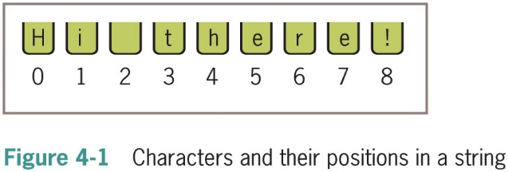
The Structure of Strings
An integer can’t be factored into more primitive parts
A string is a data structure
Data structure: Consists of smaller pieces of data
String’s length: Number of characters it contains (0+)
The len function returns the string’s length, which is the number of characters it contains
>>> len(“Hi there!”)
9
>>> len(“”)
0

Slide 6
The Subscript Operator (1 of 2)
The form of the subscript operator is:
<a string>[<an integer expression>]
Example:
>>> name = “Alan Turing”
>>> name[0] # Examine the first character
‘A’
>>> name[3] # Examine the fourth character
‘n’
>>> name[len(name)] # Oops! An index error!
Traceback (most recent call last):
File “<std in>”, line 1, in <module>
IndexError: string index out of range
>>> name[len(name) − 1] # Examine the last character
‘g’
>>> name[−l] # Shorthand for the last character
‘g’
>>> name[−2] # Shorthand for next to last character
‘n’

Slide 7
The Subscript Operator (2 of 2)
Subscript operator is useful when you want to use the positions as well as the characters in a string
Use a count-controlled loop
>>> data = “Hi there!”
>>> for index in range(len(data)):
print(index, data[index])
0 H
1 i
2
3 t
4 h
5 e
6 r
7 e
8 !

Slide 8
Slicing for Substrings
Python’s subscript operator can be used to obtain a substring through a process called slicing name[startIndex:pastIndex] (startIndex is the start index of the string. pastIndex is one past the end of the slice.)
Place a colon (:) in the subscript; an integer value can appear on either side of the colon
>>> name = “myfile.txt”
>>> name[0:] # starts at the 1st character and goes to the end of the string
‘myfile.txt’
>>> name[0:1] # The first character only (starts at 0 and goes up to - but not including - 1)
‘m’
>>> name[0:2] # The first two characters (at positions 0 through 1)
‘my’
>>> name[:len(name)] # The entire string (start at beginning & go up to but not including len(name))
‘myfile.txt’
>>> name[−3:] # The last three characters
‘txt’
>>> name[2:6] # Drill to extract 'file’ (positions 2 through 5)
‘file’

Slide 9
Testing for a Substring with the in Operator
When used with strings, the left operand of in is a target substring and the right operand is the string to be searched
Returns True if target string is somewhere in search string, or False otherwise
This code segment traverses a list of filenames and prints just the filenames that have a .txt extension:
>> x = “Mississippi”
>> if “ss” in x:
print (“Yes”)
Yes
>>> fileList = [“myfile.txt”, “myprogram.exe”, “yourfile.txt”]
>>> for fileName in fileList:
if “.txt” in fileName:
print(fileName)
my file.txt
your file.txt

Slide 10
Using the find Operator
The .find operator will return the subscript where the first occurrence of value occurs. (It returns an integer.)
stringVariable.find(value)
Example:
txt = “The world out there.“ x = txt.find("world") # This returns 4 because “world” starts print(x) # at position 4
word = “Mississippi”
x = word.find(“ss”) # This returns 2 because the first occurrence of
print(x) # “ss” starts at position 2
# (It doesn’t bother with any other occurrences.)

Slide 11
String Methods (1 of 3)
Python includes a set of string operations called methods that make tasks like counting the words in a single sentence easy
>>> sentence = input(“Enter a sentence: ”)
Enter a sentence: This sentence has no long words.
>>> listOfWords = sentence.split()
>>> print(“There are”, len(listOfWords), “words. ”)
There are 6 words.
>>> sum = 0
>>> for word in listOfWords:
sum += len(word)
>>> print(“The average word length is”, sum / len(listOfWords))
The average word length is 4.5
With split method, default separator is any whitespace (space, tab, newline).

Slide 12
String Methods (2 of 3)
A method behaves like a function, but has a slightly different syntax
A method is always called with a given data value called an object
<an object>.<method name>(<argument-1>,..., <argument-n>)
Methods can expect arguments and return values
A method knows about the internal state of the object with which it is called
In Python, all data values are objects
View a complete list and documentation of string methods by entering dir(str) at a shell prompt; you enter
help(str.<method-name>) to receive documentation on an individual method

Slide 13
String Methods (3 of 3)
Example: extracting a filename’s extension
>>> "my file.txt".split('.')
['my file', 'txt']
>>> "my file.py".split('.')
['my file', 'py']
>>> "my file.html".split('.')
['my file', 'html']
The subscript [−1] extracts the last element
Can be used to write a general expression for obtaining any filename’s extension, as follows:
filename.split('.')[−1]

Slide 14
Data Encryption (1 of 6)
It is easy to observe data crossing a network, particularly in wireless networks
Attacker may use sniffing software
Data encryption can be used to protect information transmitted on networks
Many protocols have secure versions (e.g., H T T P S)
One or more keys are use to encrypt messages to produce cipher text, and to decrypt cipher text back to its original plain text form
Examples: Caesar cipher, block cipher

Slide 15
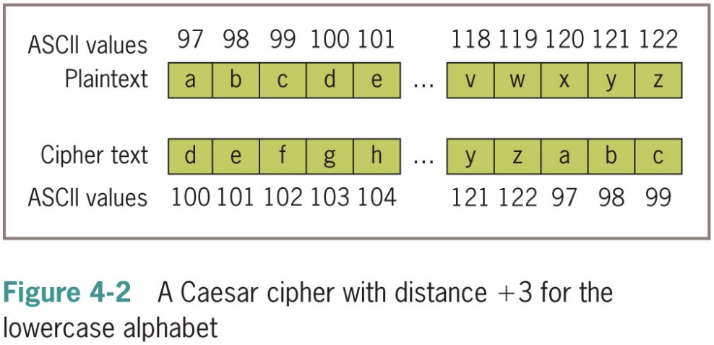
Data Encryption (2 of 6)
Caesar cipher replaces each character in plain text with a character a given distance away
Example if Caesar cipher equals three characters:
the string “invaders” would be encrypted as “l q y d g h u v”
To decrypt:
Apply a method that uses the same distance value but looks to the left of each character for replacement value

Slide 16
Data Encryption (3 of 6)
The ord function returns the ordinal position in the A S C I I sequence
The chr is the inverse function
“““
File: encrypt.py
Encrypts an input string of lowercase letters and prints
the result. The other input is the distance value.
”””
plainText = input(“Enter a one-word, lowercase message: ”)
distance = int(input(“Enter the distance value: ”))
code = “ ”
for ch in plainText:
ord value = ord(ch)
cipherValue = ord value + distance
if cipherValue > ord(‘z’):
cipherValue = ord(‘a’) + distance − (ord(‘z’) − ordvalue + 1)
code += chr(cipherValue)
print(code)

Slide 17
Data Encryption (4 of 6)
To decrypt:
“““
File: decrypt.py
Decrypts an input string of lowercase letters and prints
the result. The other input is the distance value.
”””
code = input(“Enter the coded text: ”)
distance = int(input(“Enter the distance value: ”))
plainText = “ ”
for ch in code:
ord value = ord(ch)
cipherValue = ord value − distance
if cipherValue < ord(‘a’):
cipherValue = ord(‘z’) − (distance − (ord(‘a’) − ordvalue − 1))
plainText += chr(cipherValue)
print(plainText)

Slide 18
Data Encryption (5 of 6)
Executions of the two scripts:
Enter a one-word, lowercase message: invaders
Enter the distance value: 3
l q y d g h u v
Enter the coded text: l q y d g h u v
Enter the distance value: 3
invaders
Caesar cipher worked well in ancient times, but is easy to break using modern computers

Slide 19
Strings and Number Systems (1 of 2)
Arithmetic operations use the decimal number system
Called the base ten number system 0 to 9
Binary number system is used to represent information in a digital computer
Called the base two number system (0 and 1)
Other number systems:
Octal (base eight) and hexadecimal (base 16)
415 in binary notation 110011111
415 in octal notation 637
415 in decimal notation 415
415 in hexadecimal notation 19F

Slide 20
Strings and Number Systems (2 of 2)
The digits used in each system are counted from 0 to n − 1, where n is the system’s base
To represent digits with values larger than
systems such as base 16 use
letters
Example:
represents the quantity
whereas
represents the quantity

Slide 21
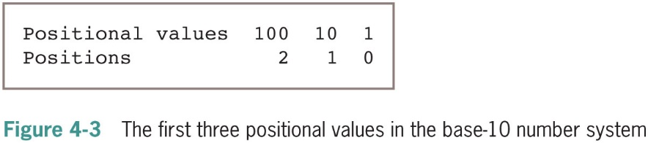
The Positional System for Representing Numbers
In positional notation, a digit has a positional value, determined by raising the
base to the power specified by the position

Slide 22
Converting Binary to Decimal (1 of 2)
Each digit or bit in binary number has positional value that is power of 2
We occasionally refer to a binary number as a string of bits or a bit string
To determine the integer quantity that a string of bits represents:

Slide 23
Converting Binary to Decimal (2 of 2)
A positional value is computed by using the ** operator
“““
File: binary to decimal.py
Converts a string of bits to a decimal integer.
”””
bitString = input(“Enter a string of bits: ”)
decimal = 0
exponent = len(bitString) − 1
for digit in bitString:
decimal = decimal + int(digit) * 2 ** exponent
exponent = exponent − 1
print(“The integer value is”, decimal)
Enter a string of bits: 1111
The integer value is 15
Enter a string of bits: 1 0 1
The integer value is 5

Slide 24
Converting Decimal to Binary (1 of 3)
How are integers converted from decimal to binary:
One algorithm uses division and subtraction instead of multiplication and addition
Repeatedly divides the decimal number by 2
After each division, the remainder (either a 0 or 1) is placed at the beginning of a string of bits
Quotient becomes the next dividend in the process
Process continues while the decimal number is greater than 0

Slide 25
Converting Decimal to Binary (2 of 3)
“““
File: decimaltobinary.py
Converts a decimal integer to a string of bits.
”””
decimal = int(input(“Enter a decimal integer: ”))
if decimal == 0:
print(0)
else:
print(“Quotient Remainder Binary”)
bitString = “ ”
while decimal > 0:
remainder = decimal % 2
decimal = decimal // 2
bitString = str(remainder) + bitString
print(“%5d%8d%12s” % (decimal, remainder, bitString))
print(“The binary representation is”, bitString)

Slide 26
Converting Decimal to Binary (3 of 3)
Result of running preceding script:
Enter a decimal integer: 34
Quotient Remainder Binary
17 0 0
8 1 10
4 0 010
2 0 0010
1 0 00010
0 1 100010
The binary representation is 100010

Slide 27
Conversion Shortcuts
A quick way to compute the decimal value of the number 10000₂ is
Decimal | Binary
0 | 0
1 | 1
2 | 1 0
3 | 1 1
4 | 1 0 0
5 | 1 0 1
6 | 1 1 0
7 | 1 1 1
8 | 1 0 0 0

Slide 28
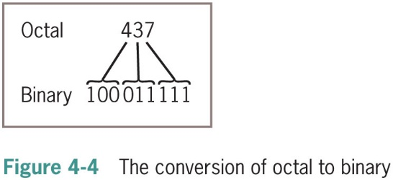
Octal and Hexadecimal Numbers (1 of 2)
To convert from octal to binary, start by assuming that each digit in the octal number represents three digits in the corresponding binary number
To convert binary to octal, you begin at the right and factor the bits into groups of three bits each

Slide 29
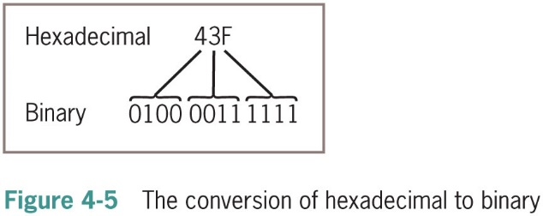
Octal and Hexadecimal Numbers (2 of 2)
To convert from hex to binary, replace each hex digit with the corresponding 4-bit binary number
To convert from binary to hex, factor the bits into groups of 4 and look up the corresponding hex digits

Slide 30
Text Files
A text file is software object that stores data on permanent medium such as disk or CD
When compared to keyboard input from human user, the main advantages of taking input data from a file are:
The data set can be much larger
The data can be input much more quickly and with less chance of error
The data can be used repeatedly with the same program or with different programs

Slide 31
Text Files and Their Format
Using a text editor such as Notepad or TextEdit, you can create, view, and save data in a text file
A text file containing six floating-point numbers might look like:
34.6 22.33 66.75
77.12 21.44 99.01
All data output to or input from a text file must be strings
Number must be converted to string before output

Slide 32
Writing Text to a File
Data can be output to a text file using a file object
To open a file for output:
>>> f = open("my file.txt", 'w')
If file does not exist, it is created
If it already exists, Python opens it; when data are written to the file and the file is closed, any data previously existing in the file are erased
This statement writes two line of text to the file:
>>> f.write("First line.\nSecond line.\n")
When all outputs are finished, close the file:
>>> f.close()

Slide 33
Writing Numbers to a File
The file method write expects a string as an argument
Other types of data must first be converted to strings before being written to output file (e.g., using str)
Code segment that illustrates the output of integers to a text file
import random
f = open(“integers.txt”, ‘w’)
for count in range(500):
number = random.randint(1, 500)
f.write(str(number) + ‘\n’)
f.close()

Slide 34
Reading Text from a File (1 of 2)
You open a file for input in a manner similar to opening a file for output
>>> f = open(“my file.txt”, ‘r’)
If the path name is not accessible from the current working directory, Python raises an error
There are several ways to read data from a file
Example: the read method
>>> text = f.read()
>>> text
‘First line.\nSecond line.\n’
>>> print(text)
First line.
Second line.

Slide 35
Reading Text from a File (2 of 2)
After input is finished, read returns an empty string
>>> f = open("my file.txt", 'r')
>>> for line in f:
print(line)
First line.
Second line.
Next code segment inputs lines of text with readline:
>>> f = open(“my file.txt”, ‘r’)
>>> while line != “”:
line = f.readline()
if line != “ ”:
line = line.strip()
print(line)
First line.
Second line.

Slide 36
Reading Numbers from a File (1 of 3)
In Python, string representations of integers and floating-point numbers can be converted to the numbers by using the functions int and float
f = open(“integers.txt”, ‘r’)
theSum = 0
for line in f:
line = line.strip()
number = int(line)
theSum += number
print(“The sum is”, theSum)

Slide 37
Reading Numbers from a File (2 of 3)
The next code segment modifies the previous one to handle integers separated by spaces and/or newlines
f = open(“integers.txt”, ‘r’)
theSum = 0
for line in f:
wordlist = line.split()
for word in wordlist:
number = int(word)
theSum += number
print(“The sum is”, theSum)

Slide 38
Reading Numbers from a File (3 of 3)
Method | What it Does
open(filename, mode) | Opens a file at the given filename and returns a file object. The mode can be ‘r’, ‘w’, ‘rw’, or ‘a’. The last two values mean read/write and append.
f.close() | Closes an output file. Not needed for input files.
f.write(aString) | Outputs aString to a file.
f.read() | Inputs the contents of a file and returns them as a single string. Returns “” if the end of file is reached.
f.readline() | Inputs a line of text and returns it as a string, including the newline. Returns “” if the end of file is reached.

Slide 39
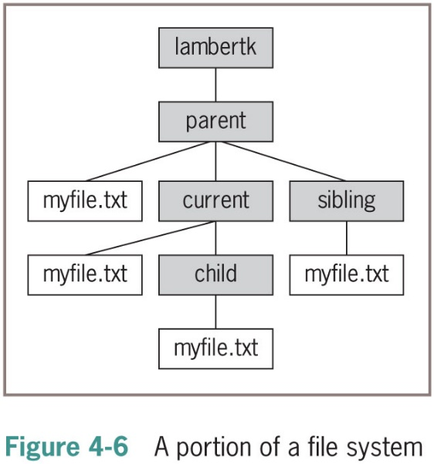
Accessing and Manipulating Files and Directories on Disk (1 of 5)
The complete set of directories and files forms a tree-like structure
With a single root directory at the top and branches down to nested files and subdirectories
You can access any other file or directory by using a pathname
When the chain starts with the root directory, it’s called an absolute pathname
When chain starts from the current working directory, it’s called a relative pathname

Slide 40
Accessing and Manipulating Files and Directories on Disk (2 of 5)
To open files named myfile.txt in the child, parent, and sibling directories, where current is the current working directory, you could use relative pathnames:
child File = open("child/my file.txt", 'r')
parent File = open("../my file.txt", 'r')
sibling File = open("../sibling/my file.txt", 'r')
Pathname | Target Directory
myfile.txt | current
child/myfile.txt | child
../myfile.txt | parent
../sibling/myfile.txt | sibling

Slide 41
Accessing and Manipulating Files and Directories on Disk (3 of 5)
When designing Python programs that interact with files, it’s a good idea to include error recovery
For example, before attempting to open a file for input, you should check to see if file exists
Function os.path.exists supports this checking
Example: To print all of the names of files in the current working directory with a .py extension:
import o s
currentDirectoryPath = o s.get c w d()
listOfFileNames = o s.list dir(currentDirectoryPath)
for name in listOfFileNames:
if “.py” in name:
print(name)

Slide 42
Accessing and Manipulating Files and Directories on Disk (4 of 5)
o’s Module Function | What it Does
ch dir(path) | Changes the current working directory to path.
get cwd() | Returns the path of the current working directory.
listdir(path) | Returns a list of the names in directory named path.
mk dir(path) | Creates a new directory named path and places it in the current working directory.
remove(path) | Removes the file named path from the current working directory.
rename(old, new) | Renames the file or directory named old to new.
rmdir(path) | Removes the directory named path from the current working directory.
sep | A variable that holds the separator character (‘/’ or ‘\’) of the current file system.

Slide 43
Accessing and Manipulating Files and Directories on Disk (5 of 5)
o s.path Module Function | What it Does
exists(path) | Returns True if path exists and False otherwise.
is dir(path) | Returns True if path names a directory and False otherwise.
is file(path) | Returns True if path names a file and False otherwise.
getsize(path) | Returns the size of the object names by path in bytes.
normcase(path) | Converts path to a pathname appropriate for the current file system; for example, converts forward slashes to backslashes and letters to lowercase on a Windows system.

Slide 44
Chapter Summary (1 of 2)
A string is a sequence of zero or more characters
The len function returns the number of characters in its string argument
A string is an immutable data structure
The subscript operator[] can be used to access a character at a given position
Can also be used for slicing ([<start>:<end>])
in operator is used to detect the presence or absence of a substring in a string
Method: operation that is used with an object
The string type includes many useful methods for use with string objects

Slide 45
Chapter Summary (2 of 2)
A text file is a software object that allows a program to transfer data to and from permanent storage
A file object is used to open a connection to a text file for input or output
Some useful methods: read, write, readline
for loop treats an input file as a sequence of lines
On each pass through the loop, the loop’s variable is bound to a line of text read from the file

